Slide 1

9
Inferences Based on Two Samples
Copyright © Cengage Learning. All rights reserved.

Slide 2
9.3
Analysis of Paired Data
Copyright © Cengage Learning. All rights reserved.

Slide 3
Analysis of Paired Data
We considered making an inference about a difference between two means μ₁ and μ₂.
This was done by utilizing the results of a random sample X₁, X₂,…X_{m} from the distribution with mean μ₁ and a completely independent (of the X’s) sample Y₁,…,Y_{n} from the distribution with mean μ₂.
That is, either m individuals were selected from population 1 and n different individuals from population 2, or m individuals (or experimental objects) were given one treatment and another set of n individuals were given the other treatment.

Slide 4
Analysis of Paired Data
In contrast, there are a number of experimental situations in which there is only one set of n individuals or experimental objects; making two observations on each one results in a natural pairing of values.

Slide 5
Example 9.8
Trace metals in drinking water affect the flavor, and unusually high concentrations can pose a health hazard.
The article “Trace Metals of South Indian River” (Envir.Studies, 1982: 62 – 66) reports on a study in which six river locations were selected (six experimental objects) and the zinc concentration (mg/L) determined for both surface water and bottom water at each location.

Slide 6
Example 9.8
cont’d
The six pairs of observations are displayed in the accompanying table. Does the data suggest that true average concentration in bottom water exceeds that of surface water?

Slide 7
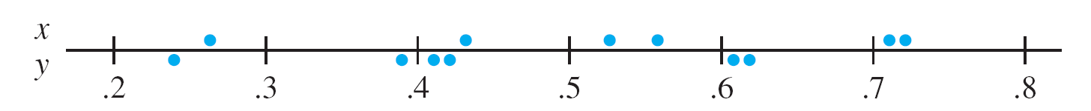
Example 9.8
cont’d
Figure 9.4(a) displays a plot of this data. At first glance, there appears to be little difference between the x and y samples.
From location to location, there is a great deal of variability in each sample, and it looks as though any differences between the samples can be attributed to this variability.
(a) observations not identified by location
Plot of paired data from Example 8
Figure 9.4

Slide 8
Example 9.8
cont’d
However, when the observations are identified by location, as in Figure 9.4(b), a different view emerges. At each location, bottom concentration exceeds surface concentration.
This is confirmed by the fact that all x – y differences displayed in the bottom row of the data table are positive.
A correct analysis of this data focuses on these differences.
(b) observations identified by location
Plot of paired data from Example 8
Figure 9.4

Slide 9
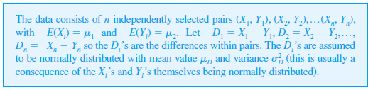
Analysis of Paired Data
Assumptions

Slide 10

Analysis of Paired Data
We are again interested in making an inference about the difference μ₁ – μ₂. The two-sample t confidence interval and test statistic were obtained by assuming independent samples and applying the rule
However, with paired data, the X and Y observations within each pair are often not independent, so and are not independent of one another.
We must therefore abandon the two-sample t procedures and look for an alternative method of analysis.

Slide 11
The Paired t Test

Slide 12
The Paired t Test
Because different pairs are independent, the D_{i}’s are independent of one another. Let D = X – Y, where X and Y are the first and second observations, respectively,
within an arbitrary pair.
Then the expected difference is
μ_{D} = E(X – Y) = E(X) – E(Y) = μ₁ – μ₂
(the rule of expected values used here is valid even when X and Y are dependent). Thus any hypothesis about
μ₁ – μ₂ can be phrased as a hypothesis about the mean
difference μ_{D}.

Slide 13
The Paired t Test
But since the D_{i}’s constitute a normal random sample (of differences) with mean μ_{D}, hypotheses about μ_{D} can be tested using a one-sample t test.
That is, to test hypotheses about μ₁ – μ₂ when data is paired, form the differences D₁, D₂,…, D_{n} and carry out a one-sample t test (based on n – 1 df) on these differences.

Slide 14
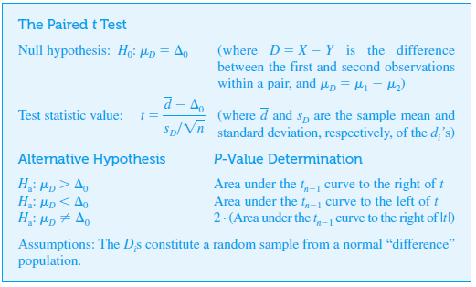
The Paired t Test

Slide 15
Example 9.9
Musculoskeletal neck-and-shoulder disorders are all too common among office staff who perform repetitive tasks using visual display units.
The article “Upper-Arm Elevation During Office Work” (Ergonomics, 1996: 1221 – 1230) reported on a study to determine whether more varied work conditions would have any impact on arm movement.

Slide 16
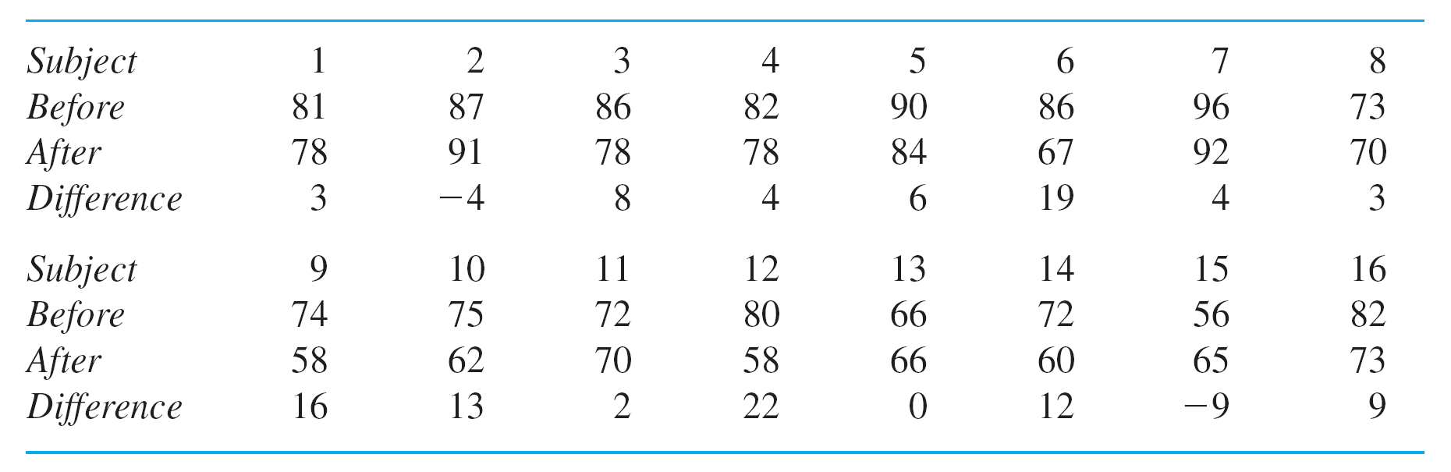
Example 9.9
cont’d
The accompanying data was obtained from a sample of
n = 16 subjects.

Slide 17
Example 9.9
cont’d
Each observation is the amount of time, expressed as a proportion of total time observed, during which arm elevation was below 30°.
The two measurements from each subject were obtained 18 months apart. During this period, work conditions were changed, and subjects were allowed to engage in a wider variety of work tasks.
Does the data suggest that true average time during which elevation is below 30° differs after the change from what it was before the change?

Slide 18
Example 9.9
cont’d
Figure 9.5 shows a normal probability plot of the 16 differences; the pattern in the plot is quite straight, supporting the normality assumption.
A normal probability plot from Minitab of the differences in Example 9
Figure 9.5

Slide 19
Example 9.9
cont’d
A boxplot of these differences appears in Figure 9.6; the boxplot is located considerably to the right of zero, suggesting that perhaps μ_{D} > 0 (note also that 13 of the 16 differences are positive and only two are negative).
A boxplot of the differences in Example 9.9
Figure 9.6

Slide 20
Example 9.9
cont’d
Let’s now test the appropriate hypotheses.
Let μ_{D} denote the true average difference between
elevation time before the change in work conditions and
time after the change.
2. H₀: μ_{D} = 0 (there is no difference between true average time before the change and true average time after the change)
3. H0: μ_{D} ≠ 0

Slide 21

Example 9.9
cont’d
4.
5. n = 16, Σd_{i} = 108, and Σ = 1746, from which = 6.75,
s_{D} = 8.234, and
6. Appendix Table A.8 shows that the area to the right of 3.3 under the t curve with 15 df is .002. The inequality in
H_{a} implies that a two-tailed test is appropriate, so the P-value is approximately 2(.002) = .004 (Minitab gives .0051).

Slide 22
Example 9.9
cont’d
7. Since .004 < .01, the null hypothesis can be rejected at either significance level .05 or .01. It does appear that the true average difference between times is something other than zero; that is, true average time after the change is different from that before the change.

Slide 23
The Paired t Confidence Interval

Slide 24

The Paired t Confidence Interval
In the same way that the t CI for a single population mean μ is based on the t variable T = a t confidence interval for μ_{D} (= μ₁ – μ₂) is based on the fact that
has a t distribution with n – 1 df. Manipulation of this t variable, as in previous derivations of CIs, yields the following 100(1 – α)% CI:

Slide 25
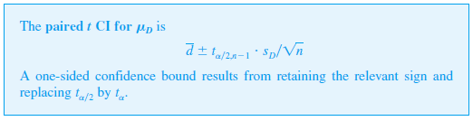
The Paired t Confidence Interval
When n is small, the validity of this interval requires that the distribution of differences be at least approximately normal.
For large n, the CLT ensures that the resulting z interval is valid without any restrictions on the distribution of differences.

Slide 26
Example 9.10
Magnetic resonance imaging is a commonly used noninvasive technique for assessing the extent of cartilage damage.
However, there is concern that the MRI sizing of articular cartilage defects may not be accurate.
The article “Preoperative MRI Underestimates Articular Cartilage Defect Size Compared with Findings at Arthroscopic knee Surgery” (Amer. J. of Sports Med., 2013: 590–595) reported on a study involving a sample of 92 cartilage defects

Slide 27
Example 9.10
cont’d
For each one, the size of the lesion area was determined
by an MRI analysis and also during arthroscopic surgery.
Each MRI value was then subtracted from the corresponding arthroscopic value to obtain a difference value.
The sample mean difference was calculated to be 1.04 cm2, with a sample standard deviation of 1.67.

Slide 28


Example 9.10
cont’d
Let’s now calculate a confidence interval using a confidence level of (at least approximately) 95% for $μ_{D}$, the mean difference for the population of all such defects (as did the authors of the cited article).
Because n is quite large here, we use the z critical value $z_{.025}=1.96$(an entry at the very bottom of our t table). The resulting CI is

Slide 29
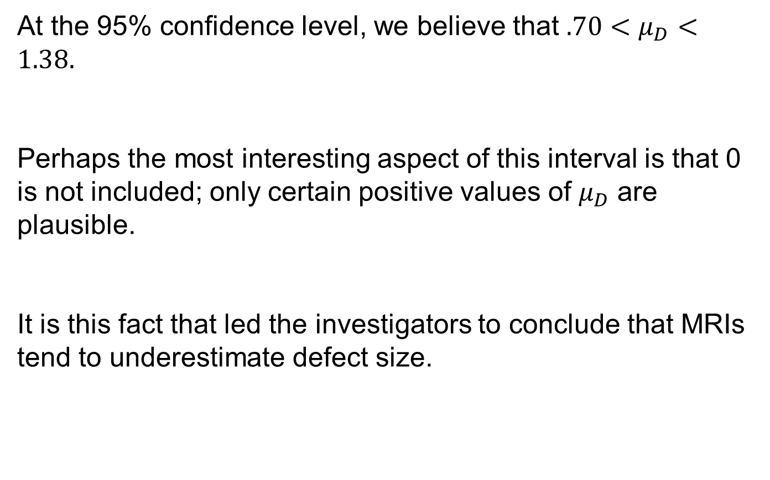
Example 9.10
cont’d
At the 95% confidence level, we believe that $.70<μ_{D}<1.38.$
Perhaps the most interesting aspect of this interval is that 0 is not included; only certain positive values of $μ_{D}$ are plausible.
It is this fact that led the investigators to conclude that MRIs tend to underestimate defect size.

Slide 30
Paired Data and Two-Sample t Procedures

Slide 31

Paired Data and Two-Sample t Procedures
Consider using the two-sample t test on paired data. The numerators of the two test statistics are identical, since
=
The difference between the statistics is due entirely to the denominators. Each test statistic is obtained by standardizing
But in the presence of dependence the two-sample t standardization is incorrect. We know that

Slide 32
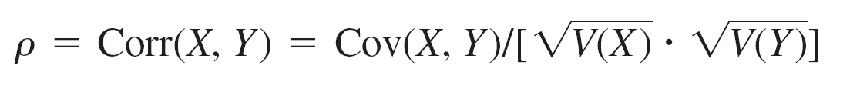


Paired Data and Two-Sample t Procedures
The correlation between X and Y is
It follows that
Applying this to yields

Slide 33
Paired Data and Two-Sample t Procedures
The two-sample t test is based on the assumption of independence, in which case ρ = 0. But in many paired experiments, there will be a strong positive dependence
between X and Y (large X associated with large Y), so that
ρ will be positive and the variance of will be smaller than
Thus whenever there is positive dependence within pairs, the denominator for the paired t statistic should be smaller than for t of the independent-samples test.

Slide 34
Paired Data and Two-Sample t Procedures
Often two-sample t will be much closer to zero than paired t, considerably understating the significance of the data.
Similarly, when data is paired, the paired t CI will usually be narrower than the (incorrect) two-sample t CI.
This is because there is typically much less variability
in the differences than in the x and y values.

Slide 35
Paired Versus Unpaired Experiments

Slide 36
Paired Versus Unpaired Experiments
In our examples, paired data resulted from two observations on the same subject (Example 9.9) or experimental object (location in Example 9.8).
Even when this cannot be done, paired data with dependence within pairs can be obtained by matching individuals or objects on one or more characteristics thought to influence responses.
For example, in a medical experiment to compare the efficacy of two drugs for lowering blood pressure, the experimenter’s budget might allow for the treatment of
20 patients.

Slide 37
Paired Versus Unpaired Experiments
If 10 patients are randomly selected for treatment with the first drug and another 10 independently selected for treatment with the second drug, an independent-
samples experiment results.
However, the experimenter, knowing that blood pressure is influenced by age and weight, might decide to create pairs of patients so that within each of the resulting 10 pairs, age and weight were approximately equal (though there might be sizable differences between pairs).
Then each drug would be given to a different patient within each pair for a total of 10 observations on each drug.

Slide 38
Paired Versus Unpaired Experiments
Without this matching (or “blocking”), one drug might appear to outperform the other just because patients in one sample were lighter and younger and thus more susceptible to a decrease in blood pressure than the heavier and older patients in the second sample.
However, there is a price to be paid for pairing—a smaller number of degrees of freedom for the paired analysis—so we must ask when one type of experiment should be preferred to the other.
There is no straightforward and precise answer to this question, but there are some useful guidelines.

Slide 39
Paired Versus Unpaired Experiments
If we have a choice between two t tests that are both valid
(and carried out at the same level of significance α), we should prefer the test that has the larger number of degrees of freedom.
The reason for this is that a larger number of degrees of freedom means smaller β for any fixed alternative value of the parameter or parameters.
That is, for a fixed type I error probability, the probability of a type II error is decreased by increasing degrees of freedom.

Slide 40
Paired Versus Unpaired Experiments
However, if the experimental units are quite heterogeneous in their responses, it will be difficult to detect small but significant differences between two treatments.
This is essentially what happened in the data set in Example 9.8; for both “treatments” (bottom water and surface water), there is great between-location variability, which tends to mask differences in treatments within locations.
If there is a high positive correlation within experimental units or subjects, the variance of will be much smaller than the unpaired variance.

Slide 41
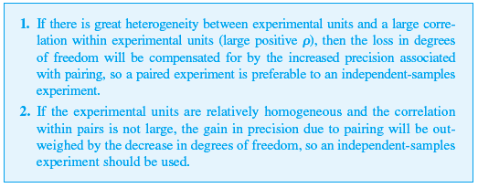
Paired Versus Unpaired Experiments
Because of this reduced variance, it will be easier to detect a difference with paired samples than with independent samples. The pros and cons of pairing can now be summarized as follows.

Slide 42
Paired Versus Unpaired Experiments
Of course, values of , and ρ will not usually be known very precisely, so an investigator will be required to make an educated guess as to whether Situation 1 or 2 obtains.
In general, if the number of observations that can be obtained is large, then a loss in degrees of freedom (e.g.,
from 40 to 20) will not be serious; but if the number is small, then the loss (say, from 16 to 8) because of pairing may be serious if not compensated for by increased precision.

Slide 43
Paired Versus Unpaired Experiments
Similar considerations apply when choosing between the two types of experiments to estimate μ₁ – μ₂ with a confidence interval.

